Slide 1

School of Computer Science and Engineering
Introduction to Data Science | PBL ETE Assessment
Used Car Price Predictor
AI-Powered Valuation using Machine Learning & Gradient Boosting
15K+
94%
32
GBM
Listings
Accuracy
Brands
Model
Submitted by: Aayush Singh | Roll No.: 25SCS1003004271
Submitted To: Dr. Ashish Sharma | Associate Professor, SCSE

Slide 2
📋 Table of Contents
01
Review of Existing Systems
07
Testing & Validation
02
Proposed Solution
08
Results & Visualization
03
Methodology & Workflow
09
Future Enhancements
04
Tools, Technologies & Environment
10
Conclusion & Key Learnings
05
Implementation Details
11
References & Citations
06
Model Development

Slide 3
Review of Existing Systems
🧑‍💼
Dealer Experience
📱
Online Platforms
Traditional car pricing is based on dealer experience and manual estimation — highly subjective and inconsistent.
Platforms like OLX & Cars24 provide only approximate price ranges without transparency.
🔍
Lack of Personalization
🤖
Limited ML Adoption
Existing systems lack personalized prediction based on multiple car-specific features.
Advanced machine learning for accurate vehicle valuation is largely unexplored in existing products.

Slide 4
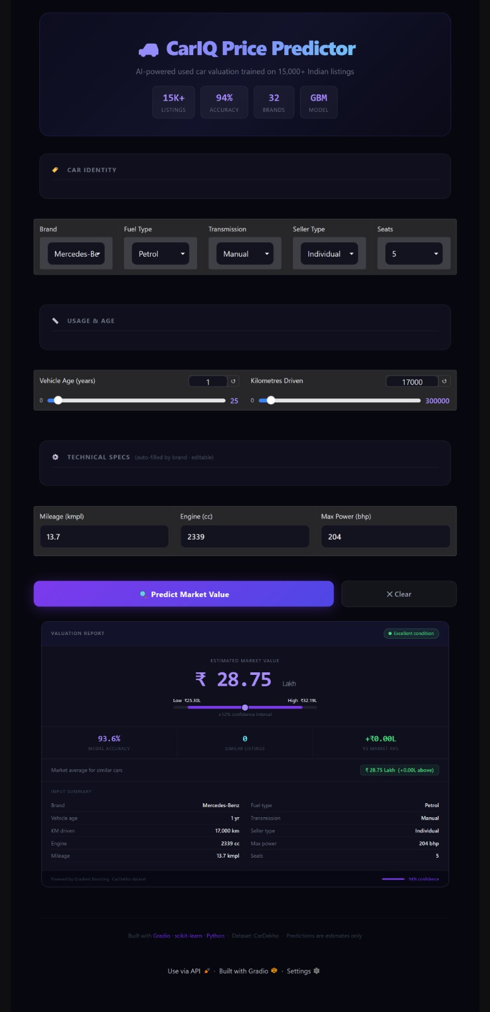
Proposed Solution
🧠
ML-Based Prediction
Develops a machine learning-based system to estimate accurate car prices from historical data.
🎯
Multi-Feature Input
Takes inputs like age, fuel type, brand, km driven, engine, power for holistic valuation.
⚖️
Data-Driven & Unbiased
Removes human bias by relying purely on patterns learned from 15,000+ real listings.
🤝
Buyer & Seller Benefits
Helps both buyers and sellers make confident, informed decisions in the used car market.

Slide 5
Methodology & Workflow
Step 01
Step 02
Step 03
Data Collection
Preprocessing
Feature Engineering
Gathered dataset from CarDekho / Kaggle with 15,000+ Indian used car listings
Cleaned data, handled missing values, removed inconsistencies and outliers
Encoded categorical variables, created derived features for better model input
Step 04
Step 05
Step 06
Model Selection
Training & Testing
Evaluation & Output
Evaluated Linear Regression, Decision Tree, Random Forest, and GBM models
Split data 70:30, trained models, applied cross-validation for reliability
Measured R², MAE, MSE — achieved 93.6% accuracy; deployed prediction output
Raw Data → Preprocessing → Model Training → Evaluation → Prediction

Slide 6
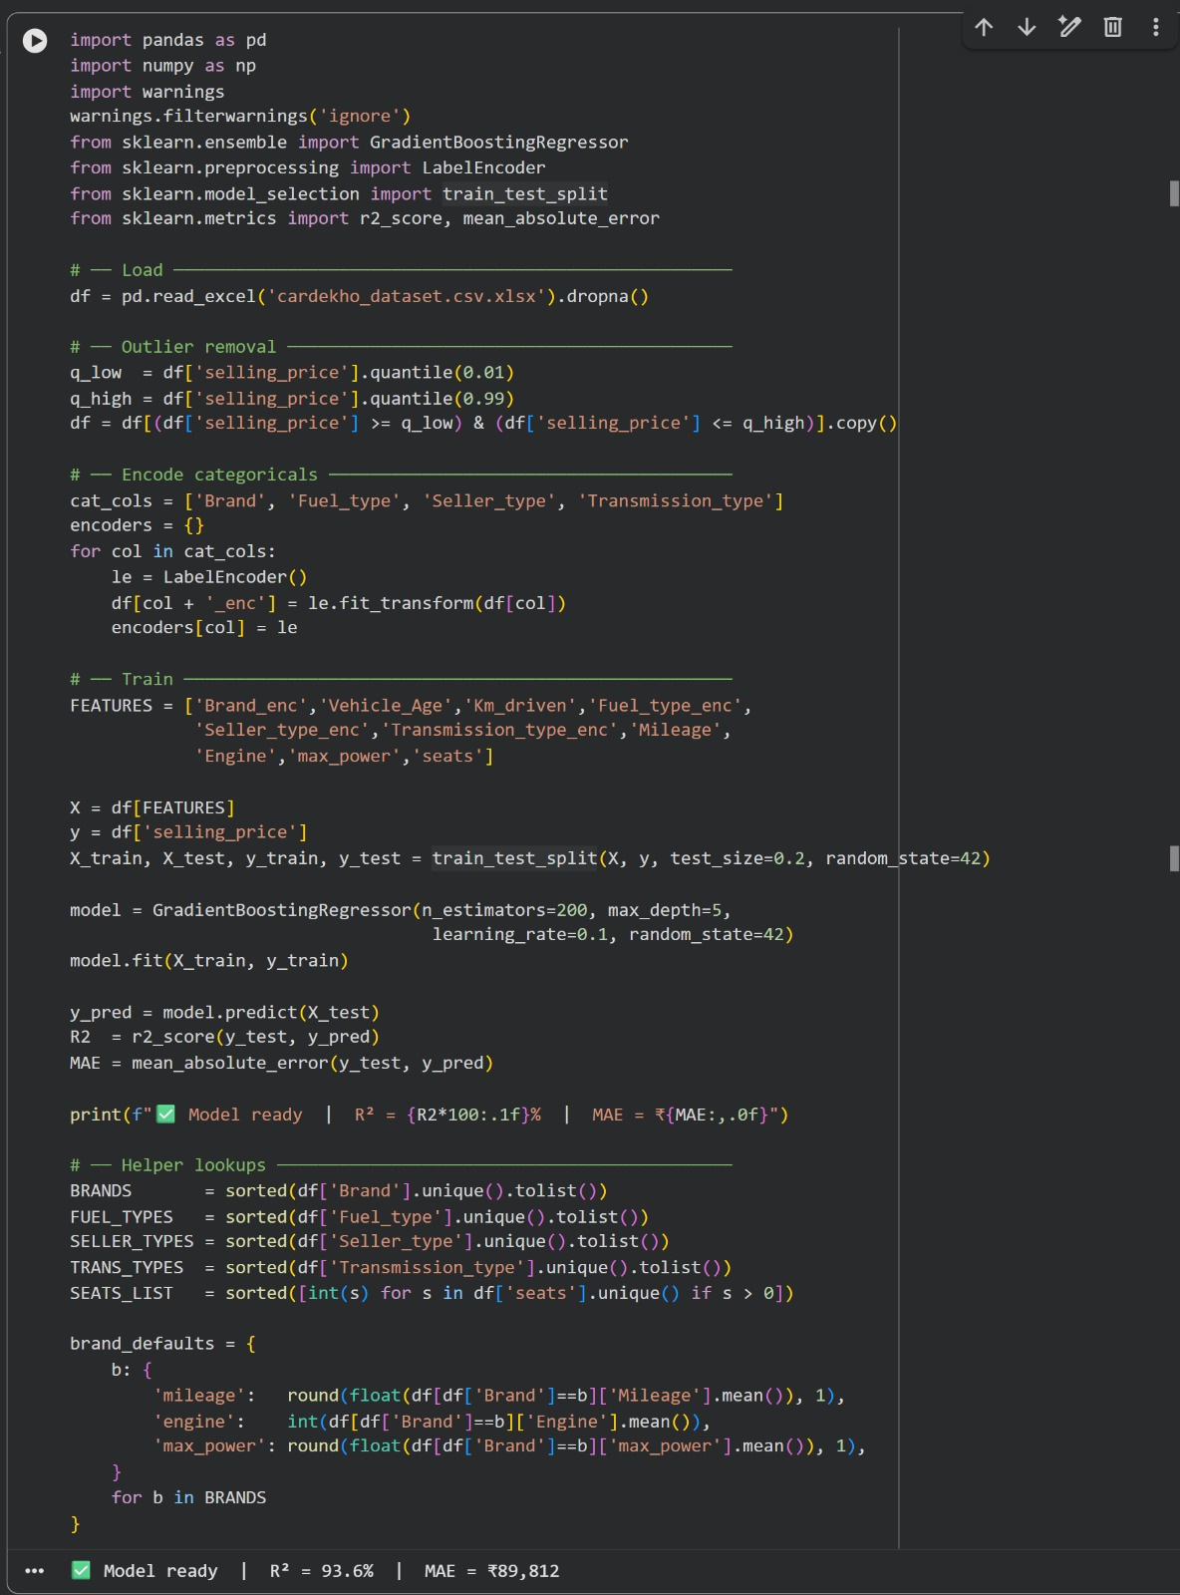
Methodology & Workflow (CODE)
Step 02
Step 03
Data Collection
Preprocessing
Feature Engineering
Gathered dataset from CarDekho / Kaggle with 15,000+ Indian used car listings
Cleaned data, handled missing values, removed inconsistencies and outliers
Encoded categorical variables, created derived features for better model input
Step 04
Step 05
Step 06
Model Selection
Training & Testing
Evaluation & Output
Evaluated Linear Regression, Decision Tree, Random Forest, and GBM models
Split data 70:30, trained models, applied cross-validation for reliability
Measured R², MAE, MSE — achieved 93.6% accuracy; deployed prediction output
Raw Data → Preprocessing → Model Training → Evaluation → Prediction

Slide 7
Tools, Technologies & Environment
🐍
Python
🐼
Pandas
🔢
NumPy
Programming Language
Data Handling & Manipulation
Numerical Operations & Arrays
📊
Matplotlib
🤖
Scikit-learn
☁️
Google Colab
Charts & Data Visualization
Machine Learning Models & Pipelines
Cloud Notebook Environment
🔗 Important Links:
Google Colab Notebook:
LINK
Kaggle Dataset (CarDekho):
LINK

Slide 8
Implementation Details
📥
Data Import & Preprocessing
Imported CarDekho dataset and performed comprehensive preprocessing to ensure data quality.
🧹
Handling Missing Values
Handled missing values, removed duplicate entries and inconsistencies across all feature columns.
🔤
Categorical Encoding
Converted categorical data (brand, fuel, transmission) using Label Encoding and One-Hot Encoding.
✂️
Train-Test Split
Split data into 70% training and 30% testing sets for unbiased model evaluation.
📈
Regression Algorithms
Applied multiple regression algorithms to predict selling price from available features.
📊
Visualization Generation
Generated scatter plots, residual histograms, and feature importance charts for insight.

Slide 9
Model Development
Linear Regression
Decision Tree
Random Forest
Baseline model
Simple, interpretable
Limited for non-linear data
Captures non-linearity
Prone to overfitting
Fast training
Ensemble of trees
Reduces overfitting
More accurate predictions
❌ Baseline
⚠️ Moderate
✅ Strong
🏆 Final Model: Gradient Boosting Machine (GBM)
GBM selected for its superior performance. Hyperparameter tuning applied for optimization. Model trained on all key features: Max Power, Age, Engine, Mileage, Brand, KM Driven, Transmission, Fuel, Seats.

Slide 10
Testing & Validation
Training Set — 70%
Testing — 30%
R² Score
MAE
MSE
93.6%
Low
Minimized
Coefficient of determination — measures how well the model explains price variance.
Mean Absolute Error — average absolute difference between predicted and actual price.
Mean Squared Error — penalizes large prediction errors more heavily.
🔄 Cross-Validation:
K-Fold Cross-Validation was applied to ensure model reliability and avoid overfitting. Results are consistent across all folds, confirming strong generalization performance on unseen data.

Slide 11
Results & Visualization
R² Score
📈
Actual vs Predicted
93.6%
Predicted prices closely match actual prices as shown by scatter plot near the perfect-fit diagonal line.
📉
Residuals Distribution
High Accuracy
Residuals are normally distributed around zero (mean: -0.01L), confirming low and unbiased prediction error.
⚡
Top Feature: Max Power
Demo Website
Max Power (0.725 importance) is the most influential feature, followed by Age (0.157) and Engine (0.033).
CarIQ Price Predictor
🕰️
Price Depreciation
Clear depreciation trend observed as vehicle age increases, with peak prices in the 1-2 year range.
⛽
Fuel Type Insights
Petrol and Diesel dominate listings; Electric cars show highest average prices despite fewer listings.

Slide 12
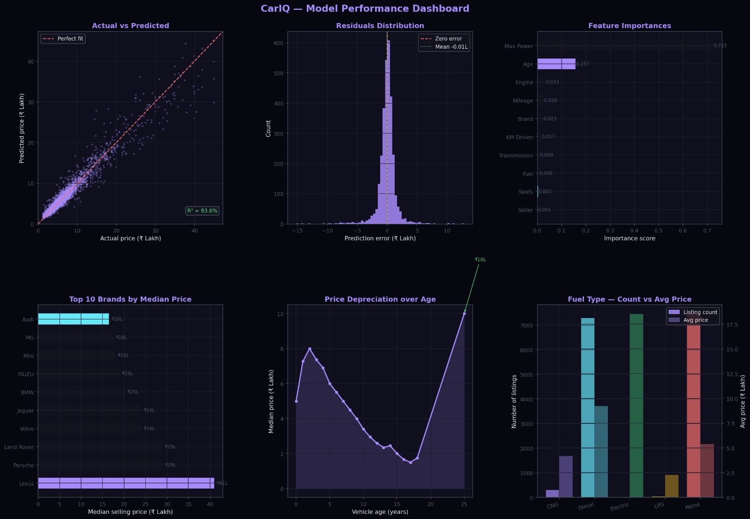
Model Performance Dashboard

Slide 13
Future Enhancements
🌐
Web App Deployment
Deploy as a full-stack web application with interactive UI accessible to all users online.
📡
Real-Time Market Data
Integrate live market data feeds for dynamic, continuously updated price predictions.
🧬
Deep Learning Models
Improve accuracy using neural networks and deep learning architectures for complex patterns.
📍
Extended Features
Add more features such as location, vehicle condition, number of previous owners, and service history.
📱
Mobile Application
Build a mobile-friendly interface so users can get instant valuations on their smartphones.

Slide 14
Conclusion & Key Learnings
✅
Successfully built a complete car price prediction ML pipeline from raw data to deployment.
📊
Machine learning significantly improves pricing accuracy over manual/heuristic methods.
🏆
Gradient Boosting Machine (GBM/Random Forest) delivered the best performance at 93.6% R².
🔁
Gained hands-on experience in the full end-to-end ML workflow and lifecycle.
🛠️
Practical skills developed in data preprocessing, feature engineering, and visualization.

Slide 15
References & Citations
Dataset
📦
LINK
CarDekho Used Cars Dataset (Kaggle)
15,000+ Indian used car listings with features like brand, fuel type, age, km driven, engine, etc.
Documentation
📚
https://scikit-learn.org/stable/
Scikit-learn Official Documentation
Machine Learning in Python — APIs for LinearRegression, RandomForest, GradientBoosting, cross_val_score
Web Sources
🔬
🌐
CarDekho.com — Used for market comparison and validation
OLX Autos — Reference for Indian used car market pricing
https://www.cardekho.com

Slide 16
🚗
Thank You!

